Slide 1
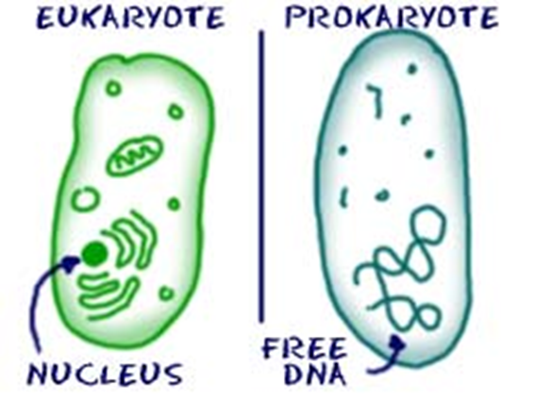
Plant and Animal Cells
Lesson Objectives:
Label the parts found inside a plant and animal cell
Describe the functions of the different parts found inside a plant and animal cell
Starter –
What is a cell? What parts can you remember?
Review:
Be prepared to share your ideas

Slide 2
Draw and label this Animal cell
2.
Cell membrane
Nucleus
1.
3.
Cytoplasm
Use these labels
Cytoplasm
Cell membrane
Nucleus
Mitochondria
Mitochondria
Where respiration takes place (where energy is made).
4.

Slide 3
Draw and label this Plant cell
2.
Cell wall
3.
Cell membrane
Nucleus
1.
4.
Cytoplasm
Mitochondria
7.
5.
vacuole
6.
chloroplasts
Use these labels
● Cytoplasm ● Cell membrane ● Nucleus ● Mitochondria ● Cell wall ● Vacuole ● Chloroplast

Slide 4
LO: Describe the function of parts found in plant and animal cells and how these are related to their overall function
Task
List the following organelles inside your book and explain what their function is within the cell:
Nucleus, cytoplasm, cell membrane, mitochondria cell wall, chloroplast, vacuole
2. Explain why a typical plant cell contains organelles that an animal cell does not
Review:
Self Assess – how many did you get correct?

Slide 5
The Animal cell
Cell membrane: It holds the cell together and controls which substances enter and leave the cell
Nucleus:
Contains genetic material and controls the activities of the cell
Cytoplasm: Where most chemical reactions take place
Mitochondria: Where respiration takes place (where energy is made)

Slide 6
The Plant cell
Cell wall: made out of cellulose and supports the cell
Cell membrane: It holds the cell together and controls which substances enter and leave the cell
Nucleus: Contains genetic material and controls the activities of the cell
Cytoplasm: Where most chemical reactions take place
Vacuole: Contains cell sap, a weak solution of sugar and salts
Mitochondria: Where respiration takes place (where energy is made)
Chloroplasts: Where photosynthesis take place (contains green chlorophyll which absorbs light)

Slide 7
LO: Describe the function of parts found in plant and animal cells and how these are related to their overall function
Task
List the following organelles inside your book and explain what their function is within the cell:
Nucleus, cytoplasm, cell membrane, mitochondria cell wall, chloroplast, vacuole
2. Explain why a typical plant cell contains organelles that an animal cell does not
Review:
Self Assess – how many did you get correct?

Slide 8
Plenary – Quick Quiz
Which part of an animal cell controls its activity?
Where do most of the chemical reactions take place in a cell?
What are mitochondria needed for in a cell?
Name three things a plant cell has, that an animal cell does not
Which organelle does photosynthesis take place in?

